Slide 1
Numerical Valuation

Slide 2
Binomial Trees
Binomial trees are frequently used to approximate the movements in the price of a stock or other asset
In each small interval of time the stock price is assumed to move up by a proportional amount u or to move down by a proportional amount d

Slide 3
Movements in Time Δt
p
Su
S
1 – p
Sd

Slide 4
Risk-Neutral Valuation
We choose the tree parameters p, u, and d so that the tree gives correct values for the mean and standard deviation of the stock price changes in a risk-neutral world

Slide 5
Tree Parameters for a Nondividend Paying Stock
Two conditions are
e ^{rΔt} = pu + (1– p)d
σ²Δt = pu ² + (1– p )d ² – [pu + (1– p )d ]²
A further condition often imposed is u = 1/ d

Slide 6
Cox Ross Rubinstein (CRR) Specification of Tree Parameters for a Nondividend Paying Stock
When Δt is small a solution to the equations is

Slide 7
Stock Prices on the Tree
S₀u ⁴
S₀u ³
S₀u ²
S₀u ²
S₀u
S₀u
S₀
S₀
S₀
S₀d
S₀d
S₀d ²
S₀d ²
S₀d ³
S₀d ⁴

Slide 8
Backwards Induction
We know the value of the option at the final nodes
We work back through the tree using risk-neutral valuation to calculate the value of the option at each node, testing for early exercise when appropriate

Slide 9
Example: Put Option
S₀ = 50; K = 50; r =10%; σ = 40%;
T = 5 months = 0.4167;
Δt = 1 month = 0.0833
The parameters imply
u = 1.1224; d = 0.8909;
a = 1.0084; p = 0.5073

Slide 10
Example (continued)

Slide 11
Example (continued)

Slide 12
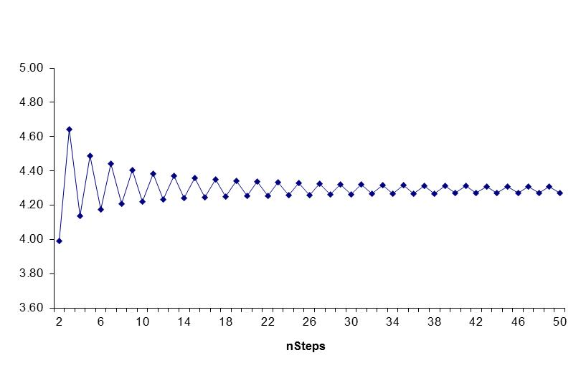
Convergence of tree

Slide 13
Calculation of Delta
Delta is calculated from the nodes at time Δt

Slide 14
Calculation of Gamma
Gamma is calculated from the nodes at time 2Δt

Slide 15
Calculation of Theta
Theta is calculated from the central nodes at times 0 and 2Δt

Slide 16
Calculation of Vega
We can proceed as follows
Construct a new tree with a volatility of 41% instead of 40%.
Value of option is 4.62
Vega is

Slide 17
Trees and Dividend Yields
When a stock price pays continuous dividends at rate q we construct the tree in the same way but set a = e^{(r – q )Δt}
For options on stock indices, q equals the dividend yield on the index
For options on a foreign currency, q equals the foreign risk-free rate
For options on futures contracts q = r

Slide 18
Binomial Tree for Stock Paying Known Dollar Dividends
Procedure:
Draw the tree for the stock price less the present value of the dividends
Create a new tree by adding the present value of the dividends at each node
This ensures that the tree recombines and makes assumptions similar to those when the Black-Scholes-Merton model is used for European options

Slide 19
Extensions of Tree Approach
Time dependent interest rates or dividend yields (u and d are unchanged and p is calculated from forward rate values for r and q)
Time dependent volatilities (length of time steps varied so that u and d remain the same)
The control variate technique (European option price calculated from tree. Error in European option price assumed to be the same as error in American option price)

Slide 20
Jarrow Rudd Binomial Tree Specification
Instead of setting u = 1/d we can set each of the 2 probabilities to 0.5 and

Slide 21
Monte Carlo Simulation
Monte Carlo simulation can be implemented by sampling paths through the tree randomly and calculating the payoff corresponding to each path
The value of the derivative is the mean of the PV of the payoff

Slide 22
Sample Python Code
if t == 0:
return max(s - k, 0)
h = t/n
u = math.exp((r - y - 0.5 * math.pow(v,2)) * h + v * math.sqrt(h))
d = math.exp((r - y - 0.5 * math.pow(v,2)) * h - v * math.sqrt(h))
drift = math.exp((r - y) * h)
discount = math.exp(- r * h)
if u == d:
q = 0.5
else:
q = (drift - d) / (u - d)
# Process the terminal stock price
stkval = np.zeros((n + 1, n + 1))
optval = np.zeros((n + 1, n + 1))
stkval[0,0] = s
for i in range(1, n + 1):
stkval[i, 0] = stkval[i-1, 0] * d
for j in range(1, i + 1):
stkval[i, j] = stkval[i - 1, j - 1] * u
# Backward recursion for option price
for j in range(n + 1):
optval[n , j] = max(0, stkval[n , j] - k)
for i in range(n - 1, -1, -1):
for j in range(i + 1):
optval[i , j] = ((1 - q) * optval[i + 1, j + 1] + q * optval[i + 1, j]) * discount
if am == 1:
optval[i , j] = max(optval[i , j], stkval[i, j] - k)
return optval[0, 0]

Slide 23
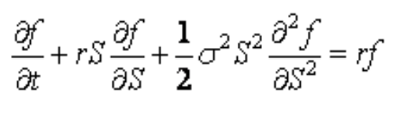
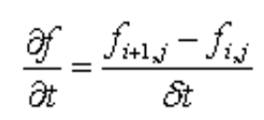
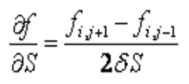
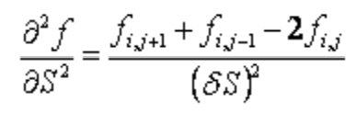
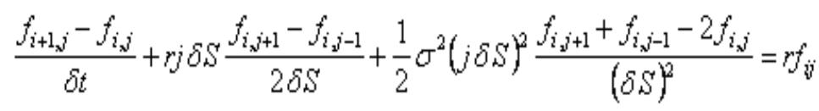
Numerical Solving the PDE
Black-Scholes PDE
Discretize
Result

Slide 24
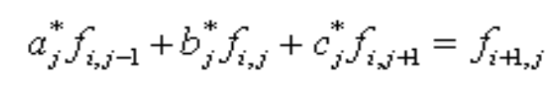
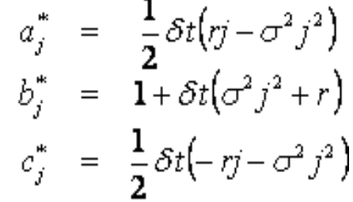
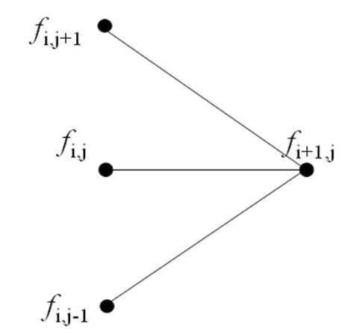
Numerical Solving the PDE
Rewrite as

